Slide 1

IS624- Web Server Project
Ubuntu 20.04
Joshua Morales
Sai Bhargav Kompalli
Aditya Venkatesh Annavarapu

Slide 2

GOAL(S)
What were we trying to accomplish?

Slide 3

Image SLide
Original Goal:
Convert Windows App to ASP.NET Project
Presentation by Sai

Slide 4
Image SLide
New Goal:
Launch a Content Management System (WordPress)
Create a virtual machine
Install the LAMP Stack
Configure the server, PHP, and database for WordPress
Access the web server outside of the VM

Slide 5
Step(S)
What did we do?

Slide 6

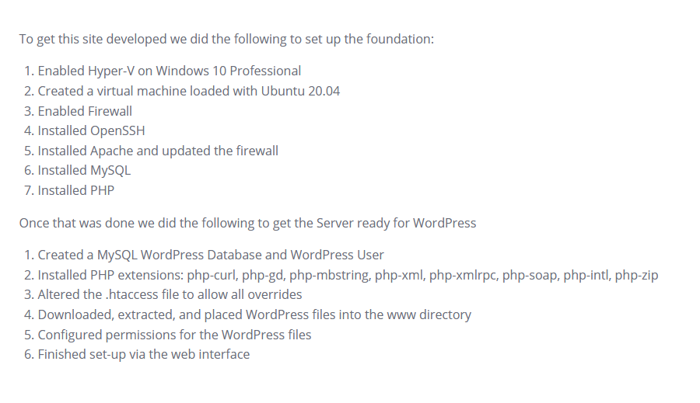
Full Setup

Slide 7
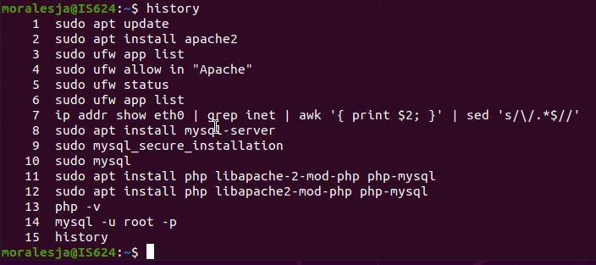
LAMP Stack Setup

Slide 8
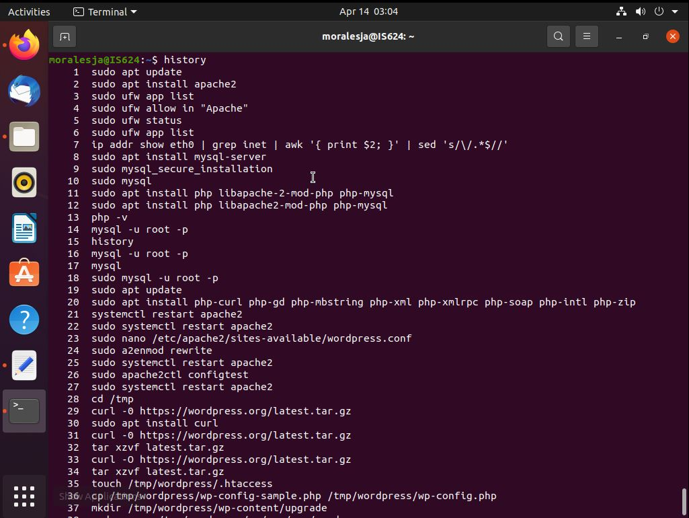
WordPress preparation

Slide 9
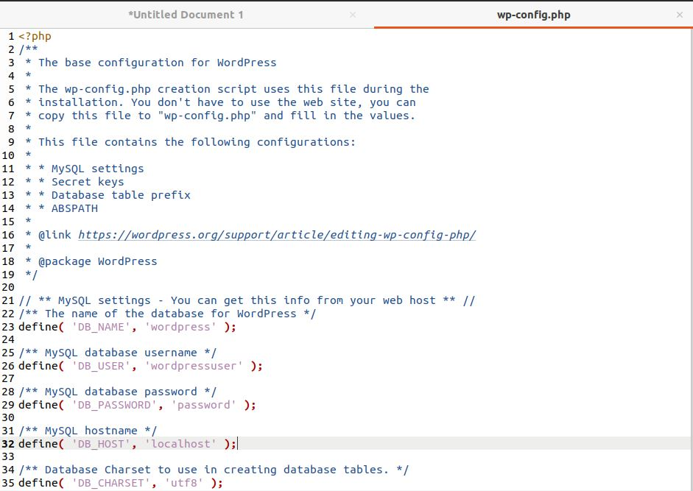
WordPress final config

Slide 10
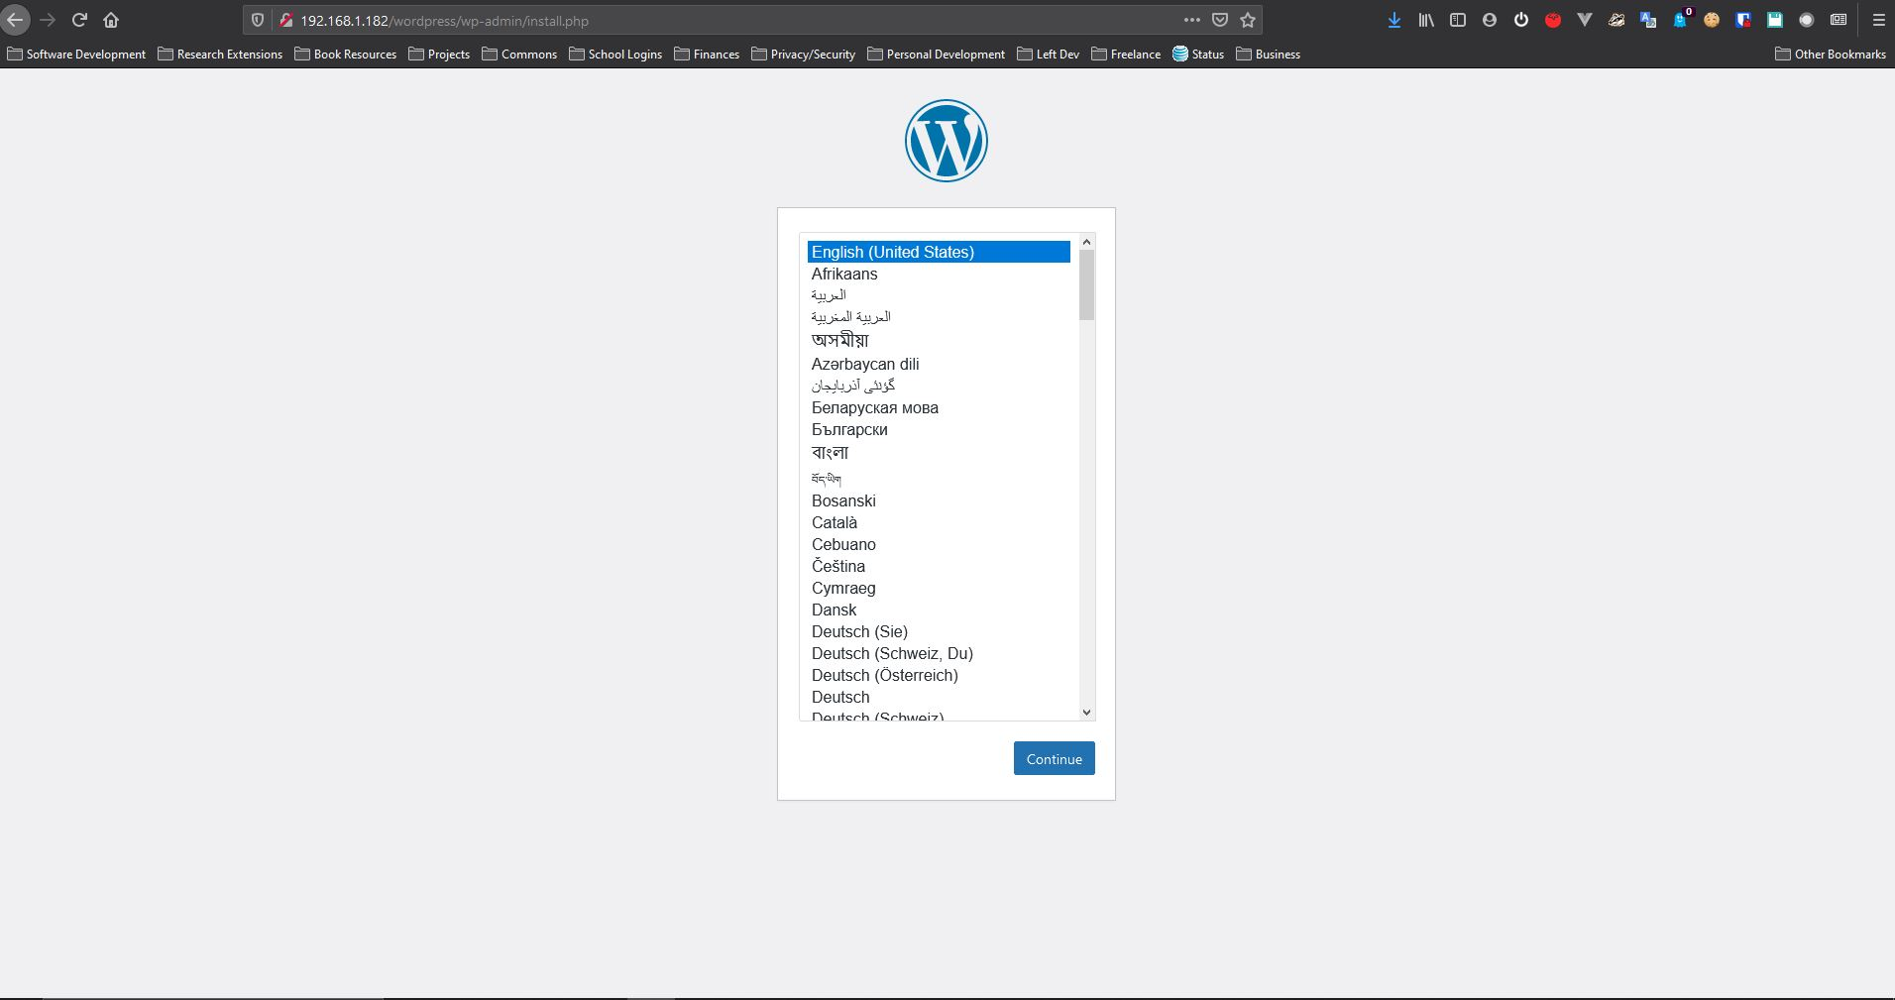
WordPress web setup

Slide 11
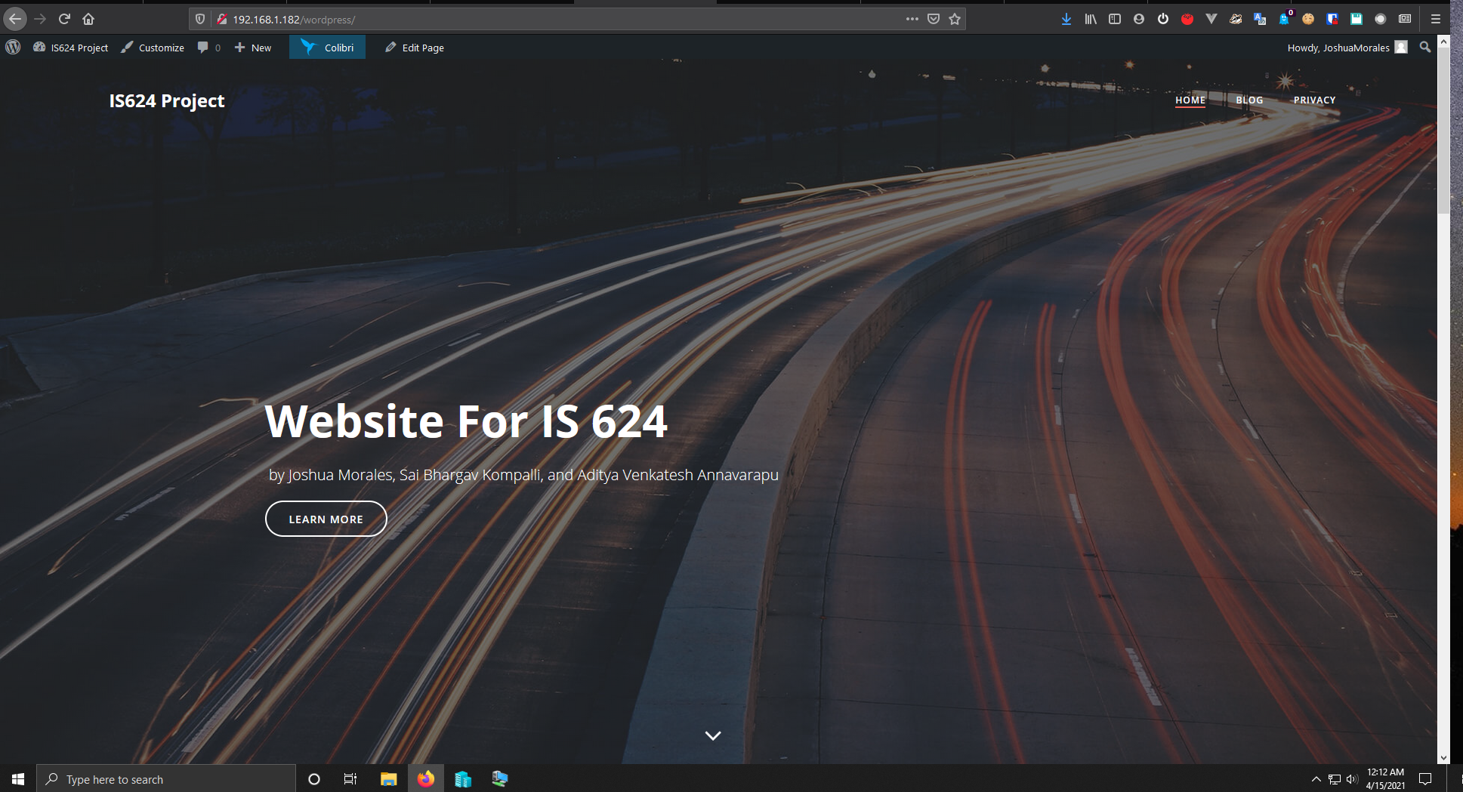
WordPress site live

Slide 12
Live demo
See what we did!

Slide 13
Questions?

Slide 14
THANK YOU

